Slide 1
TIME SERIES ANOMALY DETECTION IN HEALTHCARE

Slide 2
OBJECTIVE:
The project aims to identify anomalies in healthcare data using machine learning techniques, focusing on time series analysis. This can aid in detecting irregularities in medical signals, such as ECG, which may indicate potential health issues.
MOTIVATION:
Anomalies in healthcare data often represent critical events or abnormalities in patient health. Early detection can significantly improve diagnosis and treatment.

Slide 3
Dataset Selection :
Available Datasets for Time Series Anomaly Detection:
MIT-BIH Arrhythmia Dataset: Contains ECG recordings from patients. Widely used in arrhythmia detection studies.
PhysioNet Challenge Datasets: Includes various physiological signals like ECG, EEG, and more.
Yahoo Anomaly Detection Dataset: A synthetic dataset for benchmarking anomaly detection algorithms.
ECG5000 Dataset: Contains 5,000 ECG time series sequences, labeled for anomaly detection.
Mimic-III Dataset: large, freely-available database comprising deidentified health-related data associated with over forty thousand patients.

Slide 4
Why Choose ECG5000?
1. Compact Yet Comprehensive: The dataset offers a manageable size, enabling rapid prototyping and experimentation. Despite its size, it contains a diverse range of normal and anomalous signals, providing a rich ground for anomaly detection.
2. Pre-processed and Ready for Use: The ECG5000 dataset is pre-processed, significantly reducing preprocessing overhead. This allows us to focus on feature extraction, model design, and optimization rather than data cleaning.
3. High Relevance to Healthcare: The dataset specifically focuses on ECG signals, directly aligning with our goal of time series anomaly detection in the healthcare domain. This relevance ensures our results are meaningful and applicable to real-world scenarios.
4. Community and Benchmarking Opportunities: ECG5000 is widely used in anomaly detection research, providing well-documented benchmarks. Comparing our approach with prior studies ensures that our project is both innovative and credible.
5. Educational Value: The dataset offers an excellent opportunity to learn and explore deep learning techniques like LSTM Autoencoders in time series data.

Slide 5
RELATED RESEARCH PAPERS: 1. Le Guen, V., & Thome, N. (2024). Deep Time Series Forecasting with Shape and Temporal Criteria. 2. Siami-Namini, S., Tavakoli, N., & Namin, A. S. (2024). A Comparison of ARIMA and LSTM in Forecasting Time Series. Department of Applied Economics, Texas Tech University. Email: sima.siami-namini@ttu.edu. 3. D., Pavithra, T., Parameswaran, M. D., Choudhry, A. S., T., Deepa, R., Kiruthiga. (2024). Application of LSTM Networks for Continuous Patient Monitoring and Anomaly Detection in Wearable Health Devices. Indian Journal of Science and Technology, 17(37), 3909-3921. https://doi.org/10.17485/IJST/v17i37.260. 4. Gietzelt, M. (2024, May 5). Autoencoder-based Anomaly Detection in Time Series: Application to Active Medical Devices.

Slide 6
METHODOLOGY:
Understanding the Dataset
Data Preprocessing
Feature Engineering
Model Selection
Model Training
Evaluation
Threshold Determination
Post-Processing
Deployment
Documentation and Reporting

Slide 7
WORKFLOW SUMMARY DIAGRAM:
Data Preparation:
Load → Clean → Normalize → Split
Feature Engineering:
EDA → Statistical Features → Dimensionality Reduction (Optional)
Model Development:
Choose Model → Build → Train
Evaluation:
Detect Anomalies → Set Threshold → Evaluate
Result Comparison:
Comparing results with different approaches with this dataset
Comparing results with different dataset with same approach

Slide 8
Ecg5000 dataset overview
Source:
The dataset is publicly available on Kaggle and PhysioNet.
Widely used for ECG anomaly detection research.
Dataset Description:
Contains 5,000 single-lead ECG heartbeat records.
Records are labeled into five categories
1)Normal beats 2)Supraventricular ectopic beats.
3)Ventricular ectopic beats 4)Fusion beats 5)Unknown beats.
Each record consists of 140 data points sampled over a short period.
Preprocessing:
Normalized and cleaned to ensure consistent input to models.
Focused on detecting anomalies using normal and abnormal labels.

Slide 9
Models Explored for ECG Anomaly Detection
ARIMA (Auto-Regressive Integrated Moving Average):
Used for time series forecasting and analysis.
Captures trends and seasonality in ECG data.
Autoencoder:
A neural network trained to reconstruct input data.
Learns latent representations of normal ECG patterns.
Anomalies are detected when reconstruction error exceeds a threshold.
Variational Autoencoder (VAE):
An extension of autoencoders with probabilistic latent spaces.
Enhances robustness in anomaly detection by leveraging probabilistic reconstructions.
LSTM (Long Short-Term Memory)Autoencoder:
Combines LSTM and Autoencoder architectures.
Encodes and decodes sequential data while preserving temporal dependencies.
Detects anomalies by identifying sequences with high reconstruction error.

Slide 10
Arima vs lstm
ASPECT | ARIMA | LSTM
Model Type | Statistical Model | Deep Learning Model
Assumptions | Assumes linearity and stationarity. Requires transforming the time series if non-stationary. | No strict assumptions about data; handles non-linear relationships well.
Handling Anomalies | Identifies anomalies as deviations from a fitted statistical pattern. | Learns complex patterns and flags deviations. Best for complex and high-dimensional anomalies.
Sequential Dependency | Struggles with long-term dependencies. | Excels at capturing long-term temporal dependencies.
Feature Engineering | Requires manual feature engineering (e.g., differencing, log transformations). | Automatically learns features from data.
Interpretability | Highly interpretable due to coefficients (AR, MA, etc.). | Acts as a "black-box" model, harder to interpret results.
Accuracy | High for linear, short-term patterns. | High for complex, non-linear, long-term dependencies.
Scalability | Scales poorly for multivariate or large datasets. | Scales well with more data and multiple variables.

Slide 11
LSTM VS LSTM AUTOENCODER
Aspect | LSTM | LSTM Autoencoder
Purpose | Predicts or models sequential relationships in time-series data. | Compresses and reconstructs sequential data.
Architecture | A single network focused on sequence-to-sequence modeling. | Combines an encoder LSTM and a decoder LSTM.
Goal | Outputs predictions for future or next sequence steps. | Learns latent representations and reconstructs sequences.
Use Case | Forecasting, classification, and pattern recognition. | Anomaly detection (via reconstruction errors), dimensionality reduction.
Latent Space | Does not inherently compress data into a latent space. | Learns a lower-dimensional latent space.

Slide 12
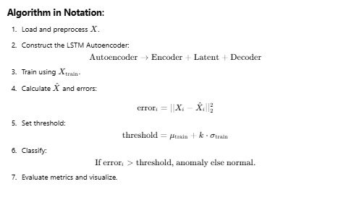
LSTM AUTOENCODER

Slide 13
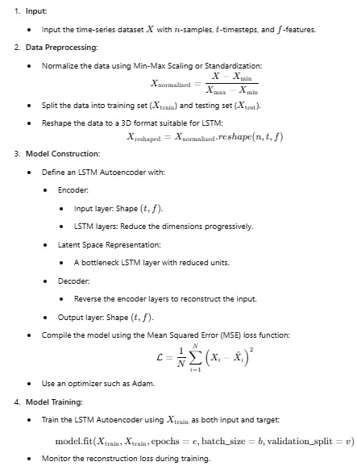
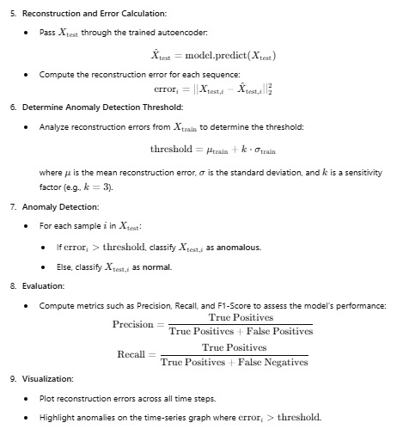
ALGORITHM:

Slide 14
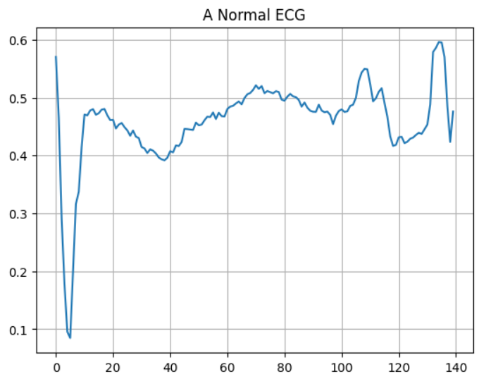
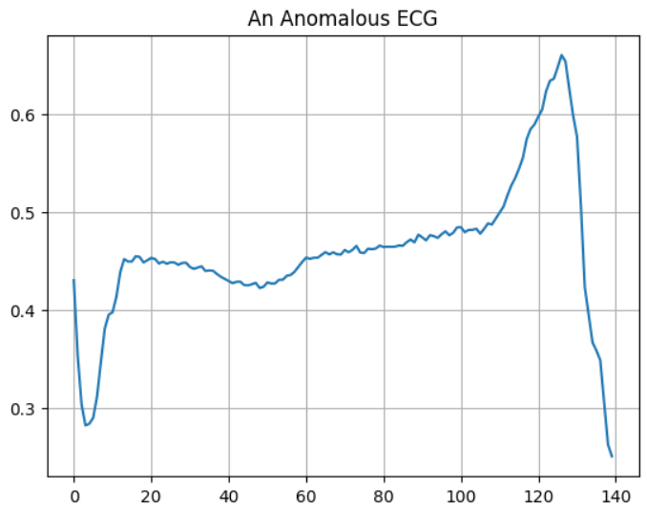
ECG SIGNALS-
A Normal ECG Signal
An Anomalous ECG Signal

Slide 15
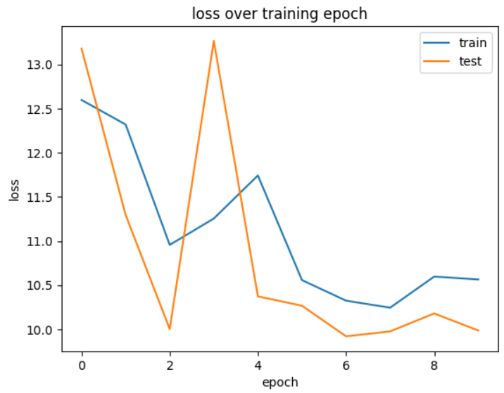
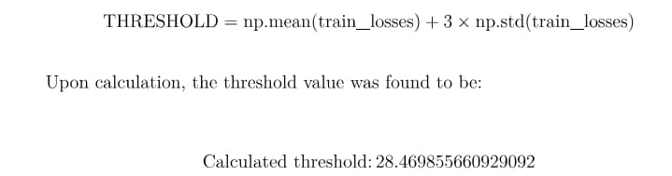
MODEL TRAINING:
Evaluation:
Reconstruction error threshold:
A Dynamic Threshold is determined based on the reconstruction error distribution of training set
Loss curves or Training/ Validation Loss Plot

Slide 16
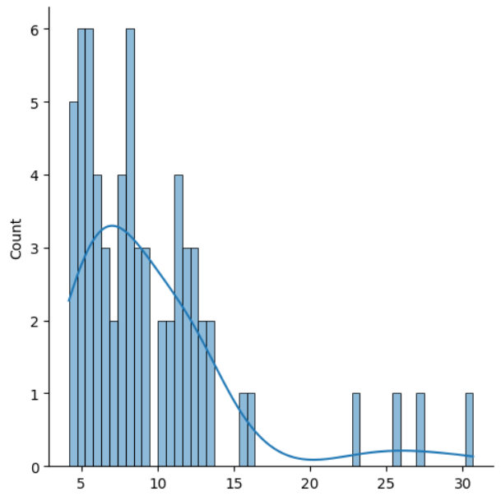
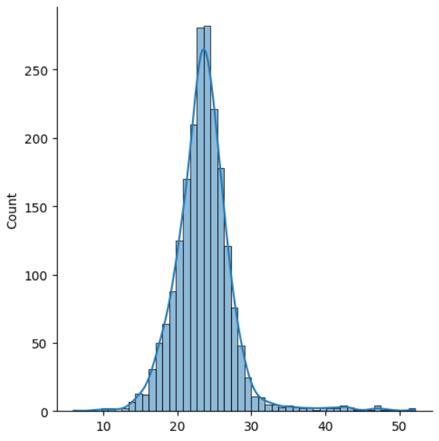
MODEL PERFORMANCE
Model trained over 10 epochs, the results observed were-
Correct normal predictions:65 out of 66
Correct anomaly predictions: 1957 out of 2081
For Normal ECG
For Anomalous ECG
Distribution of Loss Values using LSTM Autoencoders

Slide 17
Parameters of evaluation:
Reconstruction Loss: Measures the difference between the input data and its reconstruction by the autoencoder. Metric Used: Mean Absolute Error (MAE) or Mean Squared Error (MSE).
Threshold Setting: A threshold is set for reconstruction loss to classify data points as normal or abnormal.
ROC-AUC (Receiver Operating Characteristic - Area Under Curve): Measures the model's ability to distinguish between classes at various thresholds. Purpose:
A higher AUC value (closer to 1) indicates better discrimination between normal and abnormal samples.
Accuracy: Measures the proportion of correctly identified samples (both normal and abnormal).
Formula: Accuracy =
(True Positives +True Negatives)/Total Samples
Precision: Indicates how many of the detected anomalies are truly abnormal.
Formula: Precision=
True Positives /(True Positives +False Positives)
Recall (Sensitivity):Measures how many of the true anomalies were detected.
Formula: Recall=
True Positives/(True Positives +False Negatives)

Slide 18
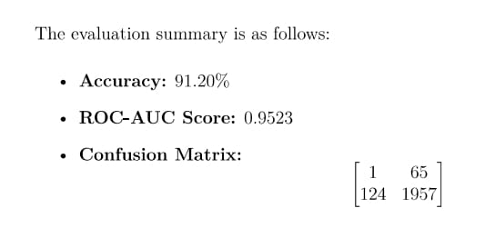
Evaluation Summary for LSTM Autoencoder:

Slide 19
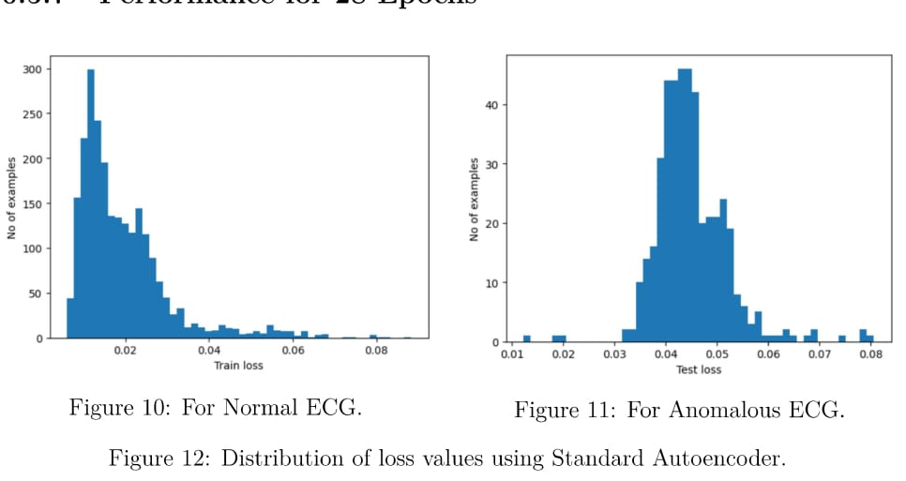
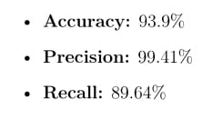
MODEL COMPARISION -
Same dataset with different ML Models
Using Autoencoders:
Evaluation results-

Slide 20
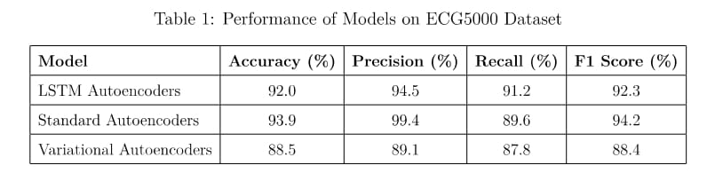
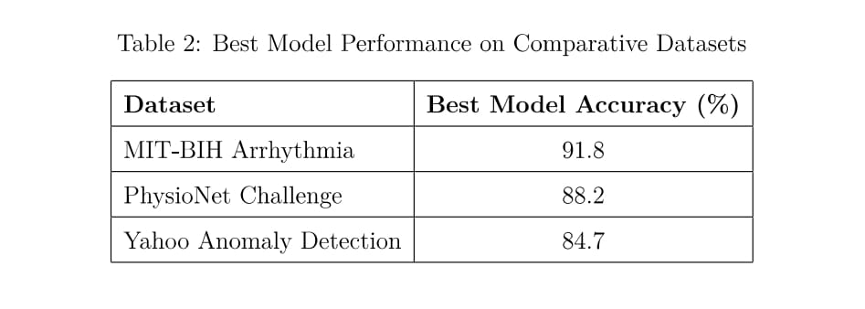
MODEL COMPARISION -
Same dataset with different ML Models:
Using LSTM Autoencoder with different datasets:

Slide 21

Thank you
P. NAGA SRIPADA - CS22B1018
VARSHITHA MASARAM - CS22B1071

